Slide 1
KNOTS AND CROSSES
Submitted in the partial fulfillment for the award of the degree of
BACHELOR OF ENGINEERING
IN
CSE Artificial Intelligence & Machine Learning
Submitted by:
Parth(20BCS6258)
Shreya Sharma(20BCS6669)
Under the Supervision of:
Ms. Neeshu Sharma
Department of AIT-CSE
DISCOVER . LEARN . EMPOWER

Slide 2
Outline
Introduction to Project
Applications
Objectives of the work
Methodology used
Results and Outputs
Conclusion
References

Slide 3
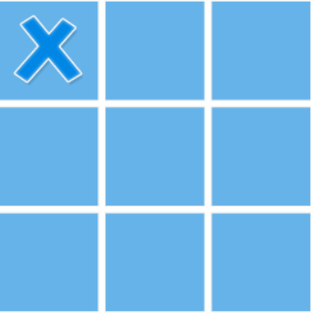
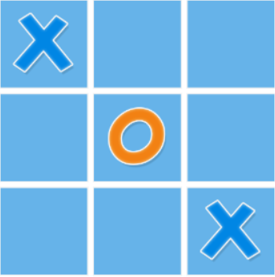
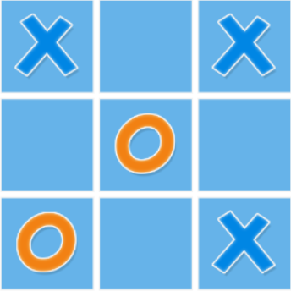
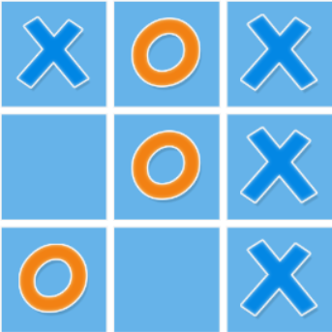
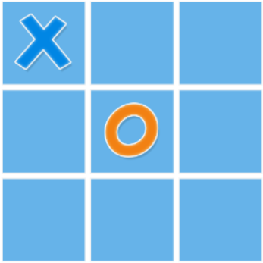
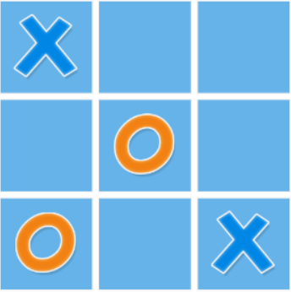
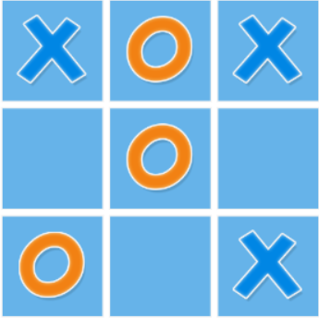
Introduction to Project
Figure 1
Knots and Crosses game with a basic ideology of Tic Tac Toe game.
This game can be played for entertainment purposes.
The game consists of grids of various dimensions like 3X3, 5X5 and 7X7.

Slide 4
The Game can be played against a fellow player or against the computer.
The user needs to place consecutive knots or crosses in order to win.
Every grid has its own rules.

Slide 5
APPLICATIONS
Thinking ability enhancement.
Entertainment purposes.
Escaping boredom.
Non-Addictive.

Slide 6
Objectives
Brings about changes in the already existing Tic Tac Toe.
More advanced.
Thinking ability enhancement along with entertainment.
Attempt to bring about our own innovation.

Slide 7
EQUIPMENT USED:
Hardware used
Operating system: Windows 10
RAM: 8GB
Storage required: 10GB
Software used:
We made the use of visual studio code for the implementation of the program. However, any offline IDE can be used to implement it.

Slide 8
METHODOLOGY
START
int main( )
WELCOME
Backspace( )
MENU
Know more
EXIT
Grid
Check for consecuitive X's or O's
3X3
Selecting Grid
5X5
CheckWinner
Check if no combination then returns d as Draw
7X7
PLAYER ONE MAKES A MOVE
Player vs Player
Player vs computer
PLAYER ONE MAKES A MOVE
Counting moves
PLAYER TWO MAKES A MOVE
COMPUTER GENRATES A MOVE
Figure 2

Slide 9
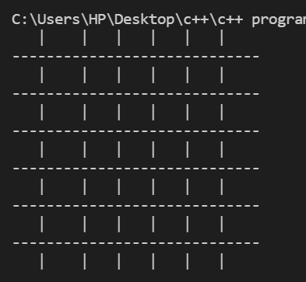
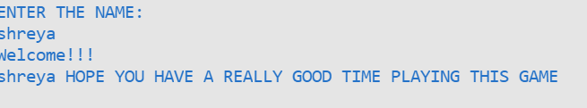
Results and Outputs
SHOW BOARD: WELCOME MESSAGE:
Figure 4
Figure 3

Slide 10

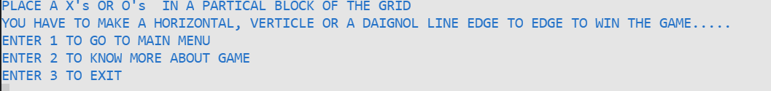
Backspace function
Know more about the game
Figure 6
Figure 5

Slide 11

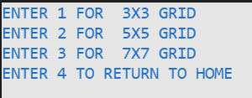
Main Menu
New Game
Figure 7
Figure 8

Slide 12
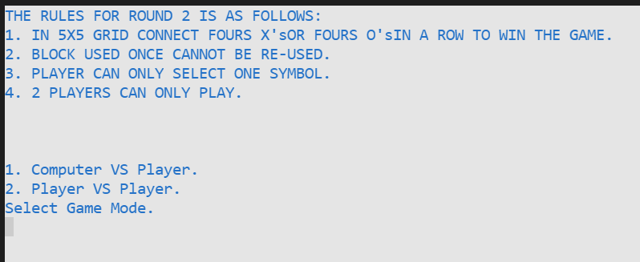
Choice for computer vs. player or player vs computer
Figure 9

Slide 13

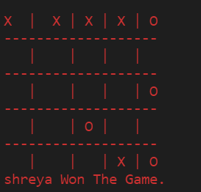
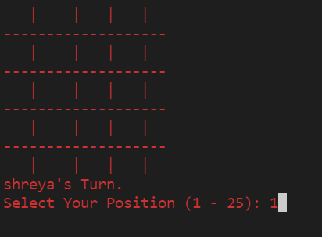
COMPUTER VS PLAYER
Selection and displaying grid
Declaring result
Figure 10
Figure 11

Slide 14
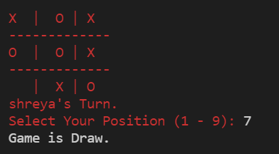
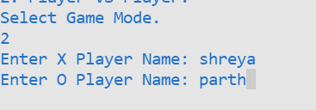
PLAYER VS. PLAYER
Selecting modes and entering name
Declaring result
Figure 12
Figure 13

Slide 15
Conclusion
Reinvented an already existing game on our own terms.
Applied basic concepts of C++.
Learned new things in the process.

Slide 16
Future Scope:
In the future we wish to do further additions to this project like linking it up with graphics using Graphical user Interface(GUI), adding larger grids to it making it more complex and entertaining these additions will be made keeping basic requirements for the device to run the code

Slide 17
References
1. Color commands:
https://www.geeksforgeeks.org/how-to-print-colored-text-in-c/
2.Bold command:
https://stackoverflow.com/questions/29997096/bold-output-in-c/29997156
3.Clear Screen command:
https://mathbits.com/MathBits/CompSci/Introduction/clear.htm
4.Game reference:
https://www.math10.com/en/math-games/tic-tac-toe/tic-tac-toe.html

